Slide 1

Disk I/O
Computer System Engineering, Fall 2019. (IPADS, SJTU)
Interrupt, PIO, MMIO, DMA
Yubin Xia

Slide 2
Review: File Cursor Sharing
fd_table
file_table
fd
index
index
inode num
file cursor
refcnt
Process A
3
115
115
23
128
1
116
23
240
2
fd
index
Process B
3
116
...
fd
index
C is B's child
3
116
Process A, B and C all open just one file with inode number 23
Process A and B open the same file, not share file cursor
Process B and C share the file cursor
Notes:
Note: the refcnt is not the refcnt of inode!

Slide 3
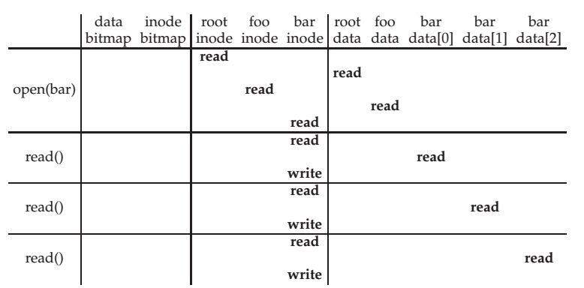
Review: File Open & Read Timeline
open("/foo/bar", O_RDONLY)

Slide 4
File Open & Read Timeline
open("/foo/bar", O_RDONLY)

Slide 5
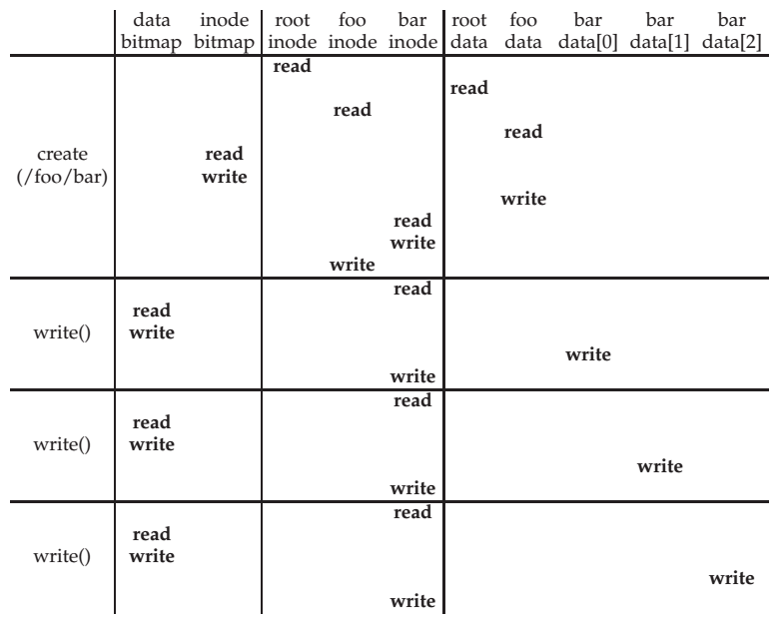
File Creation Timeline

Slide 6
WRITE & CLOSE
WRITE is similar to READ
Allocate new block if necessary
Update inode's size and mtime
CLOSE
Free the entry in the fd_table
Decrease the reference counter in file table
Free the entry in file table if counter is 0
Failures in the middle may cause inconsistency!

Slide 7
Questions
When writing, which order is preferred?
Allocate new blocks, write new data, update size
Allocate new blocks, update size, write new data
Update size, allocate new blocks, write new data

Slide 8
Delete after OPEN but before CLOSE
One process has OPENed a file
Another process UNLINKs the last name pointing to the file
Reference counter is now 0
The inode is not freed until the first process calls CLOSE

Slide 9
SYNC
Application
SYNC
File System
Buffer Cache
Block cache (aka., buffer cache)
Cache of recently used disk blocks
Read from disk if cache miss
Delay the writes for batching
Improve performance
Problem: may cause inconsistency if fail before write
SYNC
Ensure all changes to the file have been written to the storage device
Note: FLUSH is a disk command of writing disk cache to platters
Disk Driver
FLUSH
Disk Cache
Magnetic Disk

Slide 10
Canonical I/O Protocol
How to control a disk?

Slide 11
Review: Layers

Slide 12
A Canonical Device
Registers
Status
Address
Data
Command
Interface
Micro-controller (CPU)
Memory (DRAM or SRAM or both)
Other Hardware-specific Chips
Internals

Slide 13
A Canonical Protocol
While(STATUS == BUSY)
; //wait until device is not busy
Write data to DATA register and address to ADDRESS register
Write command to COMMAND register
(Doing so starts the device and executes the command )
While(STATUS == BUSY)
; //wait until device is done with your request

Slide 14
A Canonical Protocol
While(STATUS == BUSY)
; //wait until device is not busy
Write data to DATA register and address to ADDRESS register
Write command to COMMAND register
(Doing so starts the device and executes the command )
While(STATUS == BUSY)
; //wait until device is done with your request
Polling: CPU waits until the device is ready to receive a command by repeatedly reading the status register

Slide 15
A Canonical Protocol
While(STATUS == BUSY)
; //wait until device is not busy
Write data to DATA register and address to ADDRESS register
Write command to COMMAND register
(Doing so starts the device and executes the command )
While(STATUS == BUSY)
; //wait until device is done with your request
If this were a disk, then multiple writes would need to take place to transfer a disk block (say 512 Bytes) to the device
When the main CPU is involved with the data movement (as in this example protocol), we refer to it as programmed I/O (PIO)

Slide 16
A Canonical Protocol
While(STATUS == BUSY)
; //wait until device is not busy
Write data to DATA register and address to ADDRESS register
Write command to COMMAND register
(Doing so starts the device and executes the command )
While(STATUS == BUSY)
; //wait until device is done with your request
OS writes a command to the command register; doing so implicitly lets the device know that both the data is present and that it should begin working on the command

Slide 17
A Canonical Protocol
While(STATUS == BUSY)
; //wait until device is not busy
Write data to DATA register and address to ADDRESS register
Write command to COMMAND register
(Doing so starts the device and executes the command )
While(STATUS == BUSY)
; //wait until device is done with your request
OS waits for the device to finish by again polling it in a loop, waiting to see if it is finished
It may then get an error code to indicate success or failure

Slide 18
A Canonical Protocol
While(STATUS == BUSY)
; //wait until device is not busy
Write data to DATA register and address to ADDRESS register
Write command to COMMAND register
(Doing so starts the device and executes the command )
While(STATUS == BUSY)
; //wait until device is done with your request
Problem: polling wastes too much CPU
Solution: using interrupt

Slide 19
Interrupts
Lowering CPU Overhead

Slide 20
Lowering CPU Overhead With Interrupts
Instead of polling, the OS can issue a request, put the calling process to sleep, and context switch to another task
When the device finishes, it will raise a hardware interrupt
The CPU jumps into the OS at a pre-determined interrupt service routine (ISR) or more simply an interrupt handler
The handler is just a piece of OS code that will finish the request
For example, by reading data and perhaps an error code from the device, and wake the process waiting for the I/O, which can then proceed as desired

Slide 21
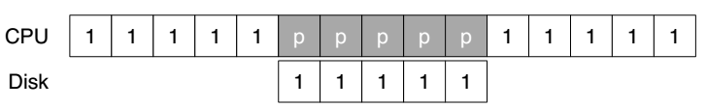
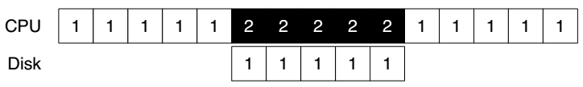
Lowering CPU Overhead With Interrupts
CPU runs thread 1
CPU is polling without doing anything
Using Polling
CPU can run thread 2
Using Interrupt

Slide 22
Example of Interrupt: Keyboard
When user depresses a key, keyboard SENDs a message to the processor containing the key value
As the processor is not ready, its bus interface:
copies the data into a temporary register,
acknowledges the keyboard,
SENDs an interrupt signal to the processor
The processor handles the interrupt in the next cycle
SENDs the value over the bus to memory module
Only suitable for slow device

Slide 23
Problem of Interrupt: Livelock
Using interrupts arises in networks
When a huge stream of incoming packets each generate an interrupt it is possible for the OS to livelock
Livelock: the CPU only processes interrupts and never allows a user-level process to run and actually service the requests
Solution: hybrid
Default using interrupts
When an interrupt happens, handle it and polling for a while to solve subsequence requests
If no further request or time-out, fall back to interrupt again
Used in Linux network driver with the name NAPI (New API)

Slide 24
Interrupt Coalescing for Optimization
A device which needs to raise an interrupt first waits for a bit before delivering the interrupt to the CPU
While waiting, other requests may soon complete, and thus multiple interrupts can be merged into a single interrupt delivery, thus lowering the overhead of interrupt processing
Note: waiting too long will increase the latency of a request, this is a common trade-off in systems

Slide 25
DMA
More Efficient Data Movement

Slide 26
DMA for Disk Device
DMA (Direct Memory Access)
A processor SENDs a request to a disk controller to READ a block of data
Including the address of a buffer in memory
The disk SENDs the data directly to memory
Incrementing the memory address appropriately

Slide 27
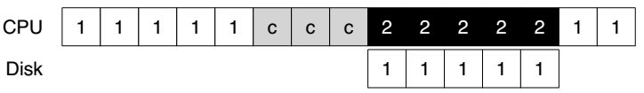
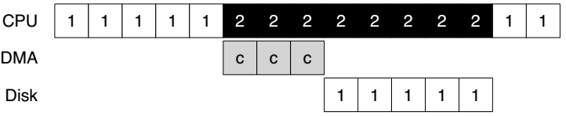
DMA for Disk Device
'c' is for copy
Without DMA
With DMA

Slide 28
DMA for Disk Device
Benefits of DMA
Relieve the CPU's load to execute other program
Reduce one transfer (original two)
Take better advantage of long message if the bus supports
Amortize the overhead of the bus protocol

Slide 29
Methods of Device Interaction
Method-1: PIO through I/O instructions
On x86, in and out instructions
Must be executed in privileged mode (kernel mode)
Method-2: Memory-mapped I/O
Using LOAD and STORE
Can also be executed in unprivileged mode (user mode)

Slide 30
I/O Instructions
Example: send data to a device by out instruction
out %eax, 0x120
Specify a register with data (%eax)
Specific an I/O Port which names the device (0x120)
I/O port: another name space, not physical memory space
Privileged instructions
Only the OS can directly communicate with devices

Slide 31
Memory Mapped I/O
Use LOAD and STORE instructions to address the register and buffer of the I/O modules
Just like access memory
Address is overloaded name with location info
Provide a uniform interface to bus modules
MMU translates virtual address to physical address
Physical address is system bus address
I/O modules translate bus address to register address internally

Slide 32
Memory Mapped I/O
Processor
Virtual address
MMU
Physical address (System bus address)
Internally translate
to register address
Memory
Disk
Keyboard

Slide 33
NOTE: Volatile Address if using MMIO
void main(void)
{
void *pdev = (void *) 0x40400000;
size_t size = (1024*1024);
int *base;
volatile int *pcid, cid;
base = mmap(pdev, size, PROT_READ|PROT_WRITE,
MAP_ANONYMOUS|MAP_PRIVATE, -1, 0);
if (base == MAP_FAILED) errx(1, "mmap failure");
pcid = (int *) (((void *) base) + 0xf0704);
cid = *pcid;
printf(“cid = %d\n", cid);
cid = *pcid;
printf(“cid = %d\n", cid);
munmap(base, size);
}
If no volatile is used, the compiler will think the two printf() are redundant and will eliminate the second memory load operation

Slide 34
Sidebar: Another Volatile Example
#include <stdio.h>
void main()
{
int i = 10;
int a = i;
printf("i= %d\n",a);
// Change value of i
__asm {
mov dword ptr [ebp-4], 20h
}
int b = i;
printf("i= %d\n",b);
}
Is volatile needed here?
Notes:
Yes. The compiler does not know [ebp-4] is the address of i.

Slide 35
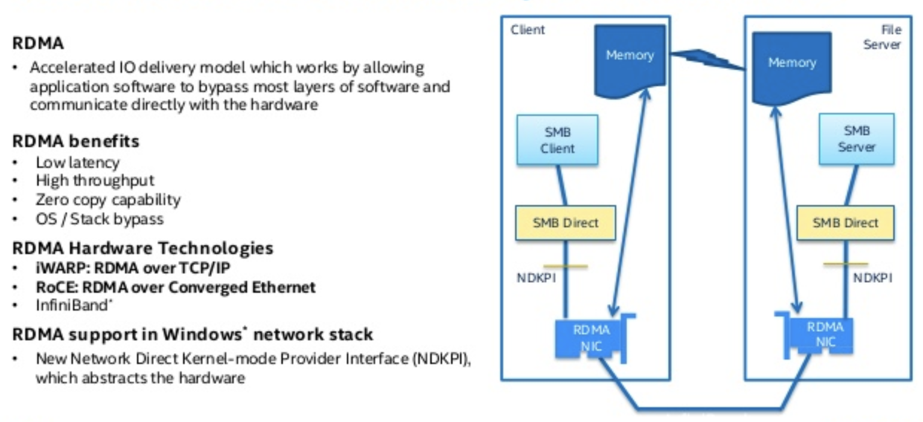
Sidebar: RDMA (Remote DMA)

Slide 36
Case Study: IDE Disk Driver

Slide 37
IDE Protocol
Address 0x1F0 = Data Port
Address 0x1F1 = Error
Address 0x1F2 = Sector Count
Address 0x1F3 = LBA low byte
Address 0x1F4 = LBA mid byte
Address 0x1F5 = LBA hi byte
Address 0x1F6 = 1B1D TOP4LBA: B=LBA, D=drive
Address 0x1F7 = Command/status
Wait for drive to be ready (0x1F7)
Read Status Register until drive is READY and not BUSY
Write parameters to command registers (0x1F2 – 0x1F6)
Sector count
Logical block address (LBA) of the sectors to be accessed
Drive number
Master=0x00 or slave=0x10, as IDE permits just two drives
Start the I/O (0x1F7)
By issuing read/write to command register
Write READ / WRITE command to command register

Slide 38
IDE Protocol
Address 0x1F0 = Data Port
Address 0x1F1 = Error
Address 0x1F2 = Sector Count
Address 0x1F3 = LBA low byte
Address 0x1F4 = LBA mid byte
Address 0x1F5 = LBA hi byte
Address 0x1F6 = 1B1D TOP4LBA: B=LBA, D=drive
Address 0x1F7 = Command/status
Data transfer (for writes)
Wait until drive status is READY and DRQ (drive request for data)
Write data to data port
Handle interrupts
In the simplest case, handle an interrupt for each sector transferred
More complex approaches allow batching and thus one final interrupt when the entire transfer is complete
Error handling
After each operation, read the status register
If the ERROR bit is on, read the error register for details

Slide 39
IDE Disk Driver using PIO
Address 0x1F0 = Data Port
Address 0x1F1 = Error
Address 0x1F2 = Sector Count
Address 0x1F3 = LBA low byte
Address 0x1F4 = LBA mid byte
Address 0x1F5 = LBA hi byte
Address 0x1F6 = 1B1D TOP4LBA: B=LBA, D=drive
Address 0x1F7 = Command/status
static int ide_wait_ready() {
while (((int r = inb(0x1f7)) & IDE_BSY) || !(r & IDE_DRDY))
; // loop until drive isn't busy
}
static void ide_start_request(struct buf *b) {
ide_wait_ready();
outb(0x3f6, 0); // generate interrupt
outb(0x1f2, 1); // how many sectors?
outb(0x1f3, b->sector & 0xff); // Block address here ...
outb(0x1f4, (b->sector >> 8) & 0xff); // ... and here
outb(0x1f5, (b->sector >> 16) & 0xff); // ... and here!
outb(0x1f6, 0xe0 | ((b->dev&1)<<4) | ((b->sector>>24)&0x0f));
if(b->flags & B_DIRTY){
outb(0x1f7, IDE_CMD_WRITE); // this is a WRITE
outsl(0x1f0, b->data, 512/4); // transfer data too!
} else {
outb(0x1f7, IDE_CMD_READ); // this is a READ (no data)
}
}
Status
Register
(0x1F7):
7: BUSY
6: READY
5: FAULT
4: SEEK
3: DRQ
2: CORR
1: IDDEX
0: ERROR
Error
Register
(0x1F1):
7: BBK
6: UNC
5: MC
4: IDNF
3: MCR
2: ABRT
1: T0NF
0: AMNF
BBK = Bad Block
UNC = Uncorrectable data error
MC = Media Changed
IDNF = ID mark Not Found
MCR = Media Change Requested
ABRT = Command aborted
T0NF = Track 0 Not Found
AMNF = Address Mark Not Found

Slide 40
IDE Disk Driver using PIO
void ide_rw(struct buf *b) {
acquire(&ide_lock);
for (struct buf **pp = &ide_queue; *pp; pp=&(*pp)->qnext)
; // walk queue
*pp = b; // add request to end
if (ide_queue == b) // if q is empty
ide_start_request(b); // send req to disk
while ((b->flags & (B_VALID|B_DIRTY)) != B_VALID)
sleep(b, &ide_lock); // wait for completion
release(&ide_lock);
}

Slide 41
IDE Disk Driver using PIO
void ide_intr() {
struct buf *b;
acquire(&ide_lock);
if ((b = idequeue) == 0) {
release*&idelock); return;
}
idequeue = b-> next;
if (!(b->flags & B_DIRTY) && ide_wait_ready() >= 0)
insl(0x1f0, b->data, 512/4); // if READ: get data
b->flags |= B_VALID;
b->flags &= ~˜B_DIRTY;
wakeup(b); // wake waiting process
if (ide_queue != 0) // start next request
ide_start_request(ide_queue); // (if one exists)
release(&ide_lock);
}

Slide 42
BUS: a hardware layer

Slide 43
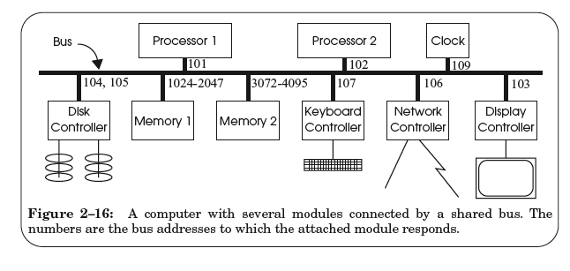
A Hardware Layer: the Bus

Slide 44
Bus Features
A set of wires
Comprising address, data, control lines that connect to a bus interface on each module
Broadcast link
Every module hears every message
Bus address: identify the intended recipient, as the name
Bus arbitration protocol
Decide which module may send or receive message at any particular time
Bus arbiter (optional): a circuit to choose which modules can use the bus

Slide 45
Bus Transaction
Source module requires exclusive use of the bus: the data sender
Source module places a bus address of the destine module on the bus
Source module signals READY wire to alert the other module
The destine module singles ACKNOWLEDGE wire after copied the data
If synchronized, then READY & ACKNOWLEDGE are not needed, just need to check the address lines on each clock cycle
Source module releases the bus

Slide 46
Memory Load Example: LOAD 1742, R1
Processor #2 => all bus modules: {1742, READ, 102}

Slide 47
Memory Load Example: LOAD 1742, R1
Memory 1 recognizes the address is within its range
By examining just a few high-order address bits

Slide 48
Memory Load Example: LOAD 1742, R1
Memory 1 acknowledges and processor 2 releases the bus
Memory 1 performs the internal operation to get the value
value <- READ (1742)

Slide 49
Memory Load Example: LOAD 1742, R1
Memory1 => all bus modules: {102, value}

Slide 50
Memory Load Example: LOAD 1742, R1
Processor 2 is waiting for this result, just copies the data on the bus to its register R1

Slide 51
Memory Load Example: LOAD 1742, R1
Processor 2 acknowledges and memory 1 releases the bus

Slide 52
Sync VS. Async
Sync data transfer
Source & destination cooperate through a shared clock
Async data transfer
Source and destination cooperate through explicit signal line
E.g., acknowledge line

Slide 53
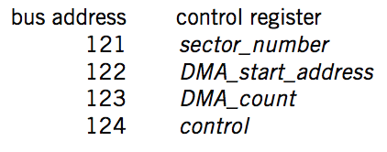
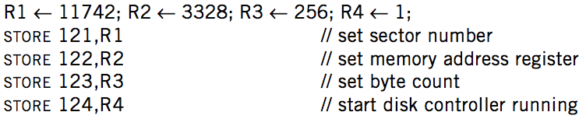

DMA on Bus

Slide 54
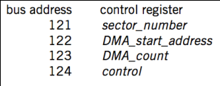
DMA Example
Processor 1
Processor 2
101
102
256-511
3072-4095
121-124
BIOS
Memory
Disk
Processor #1 => all bus modules: {121, WRITE, 11742}
Disk acknowledge and write the value 11742 to its control register
Processor #1 => all bus modules: {122, WRITE, 3328}
Processor #1 => all bus modules: {123, WRITE, 256}
Processor #1 => all bus modules: {124, WRITE, 1}

Slide 55
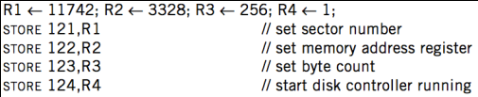
DMA Example
Processor 1
Processor 2
101
102
256-511
3072-4095
121-124
BIOS
Memory
Disk
Disk => all bus modules: {3328, WRITE, data[11742]}
Memory acknowledge and save data[11742]
Disk => all bus modules: {3329, WRITE, data[11743]}
... (loop)
Disk => all bus modules: {3583, WRITE, data[11997]}

Slide 56
DMA Example
Processor 1
Processor 2
101
102
256-511
3072-4095
121-124
BIOS
Memory
Disk
When transferring is finished, disk controller SENDs message to the processor
Just like keyboard controller does when press a key
Processor will enter interrupt handler next cycle
Now the processor knows that the DMA is done

Slide 57
Summary

Slide 58
Summary
CPU interacts with physical memory
Through system bus that connects each other
Using physical address to name memory content
CPU interacts with a device
Also using physical address (aka., bus address)
Polling, interrupt and DMA
I/O instruction (PIO) or MMIO

Slide 59
Summary
Memory Load/Store
Between CPU and memory
Physical memory address space
I/O Operations
MMIO: map device memory and registers into physical address space
DMA
Also using physical address
Processor
PIO (in/out)
/MMIO (load/store)
load/store
Memory
DMA
I/O Device

Slide 60
Questions
Q: How are the physical addresses assigned?
Memory physical addresses: by BIOS
Some devices (e.g., keyboard, IDE): fixed for all time
Other devices: assigned by the OS

Slide 61
Questions
Q: Why not map the whole disk to memory?
So that the CPU can access a byte on the disk directly by system bus
1. Too large
2. Too slow
The principle of least astonishment:
People are part of the system. The design should match the user's experience, expectations, and mental models
Q: now Intel's 3D-xpoint is 512GB memory, why disk?

